Slide 1
Week 4
Inference: Distribution tests and power analysis

Slide 2
Session overview
Topics
Examples
t-tests
Proportion tests
Power analysis
Motor Trend cars
US Dept. of Health covid-19
1950 Doll & Hill lung cancer study

Slide 3
Purpose of statistics
Description of the population or sample.
Inferences from the sample to the population. This includes differences between groups in the population.

Slide 4
Distribution tests
Compare 2 or more distributions of different groups on the same outcome. Does not test causality but can help.
Parametric tests such as the t-test. It uses a sampling distribution and tests whether the difference exceeds a critical value that denotes significance. Helpful in smaller samples, it resembles the normal distribution when N > 500. Only compares 2 groups.
Non-parametric tests such as the binomial proportion test. It does not use a sampling distribution but still tests whether the difference exceeds a critical value that denotes significance. Can compare 2 or more groups.

Slide 5
Different reasons for using distribution tests
Reasons
Examples
Check to see if 2 groups have significantly different rates.
Assess if rates of 2 years differ.
Test a hypothesis.
Compare if CA and NY differ significantly in covid death rates.
The readmission rate in 2021 is better than in 2020.
The intervention program reduced CHF deaths 20% as expected. Is it significant?

Slide 6
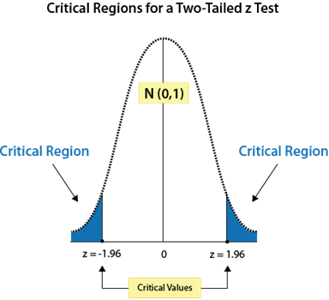
Significance tests and sampling distributions
The red circles form the “sampling distribution”.
The white region between the blue is 95% of the graph area. This is the 95% Confidence interval.
If our study’s rare group difference falls into the (blue) critical region, that indicates there is at most a 5% chance of being wrong when we say there is a significant difference.
A significance test indicates when estimated group differences are not likely to be in the normal range.
p < 0.05
p < 0.01
p < 0.001

Slide 7
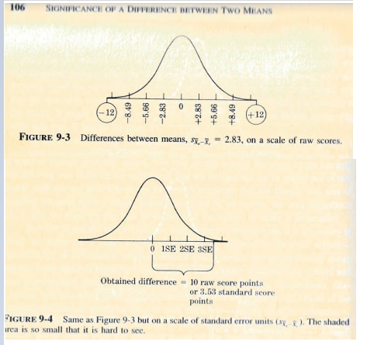
Sampling distributions on group differences
We want to test if our group difference is significantly different from 0 (0= no difference). When a test statistic exceeds the critical value (positive or negative), we have significant results.
We can have sampling distributions on differences in average values between 2 groups.
Group 1 – Group 2 = 10.
The difference between Group A and Group B is 10 points.
The Standard Error= 2.83
Test statistic= 10/ 2.83= 3.53
Surpassed the critical value of 1.96, have significant results.
When we examine group differences, correlation or regression coefficients, etc., we assume the mean is 0 with negative to positive values.

Slide 8
Power
Definition: The probability of obtaining statistical significance, and thus rejecting the null hypothesis, if the alternative hypothesis is true.
Power gives us the probability that we are correct in saying we have significant results. We use it to determine the sample size needed to get power or the level of power if we already have our sample.
For example, we conduct an experiment and find that Treatment B is better than Treatment A and has a power level of 0.80. If we conduct the same experiment 100 times, we would expect to see significant results in about 80 of the 100 trials.
A suggested power level is 0.80 (when alpha=0.05). Attaining levels over 0.90 are considered costly in terms of sample size or requires very high effect sizes in smaller samples.

Slide 9
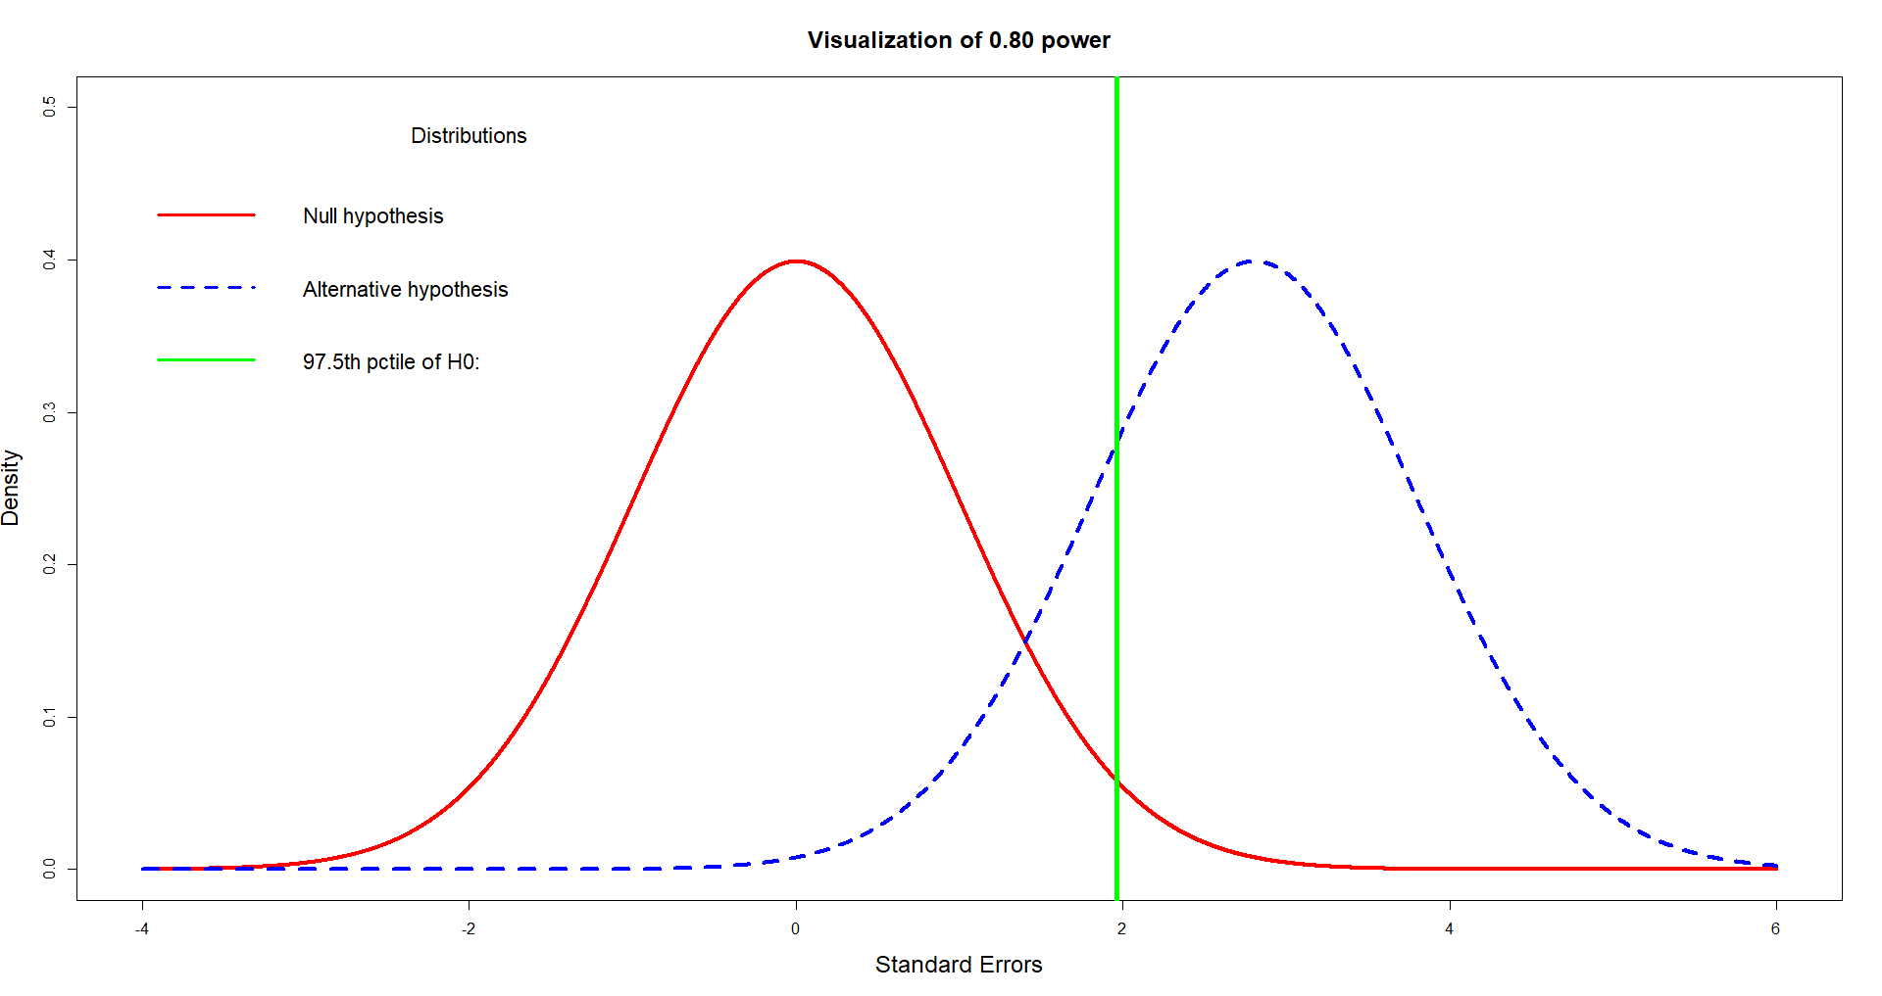
Estimated pop. distributions
E.g., 80% (power) of the estimated population distribution of means for Treatment B is above the top 2.5% of Treatment A.
Effect size
What increases power?
Higher effect sizes
Higher sample sizes
Higher alpha levels
Distribution of means if the null hypothesis is true
Distribution of means if the alternative hypothesis is true

Slide 10
Examples
T-tests: Miles-per-gallon, CA/NY covid deaths. Proportion test and power: Doll & Hill smoking and lung cancer study.

Slide 11
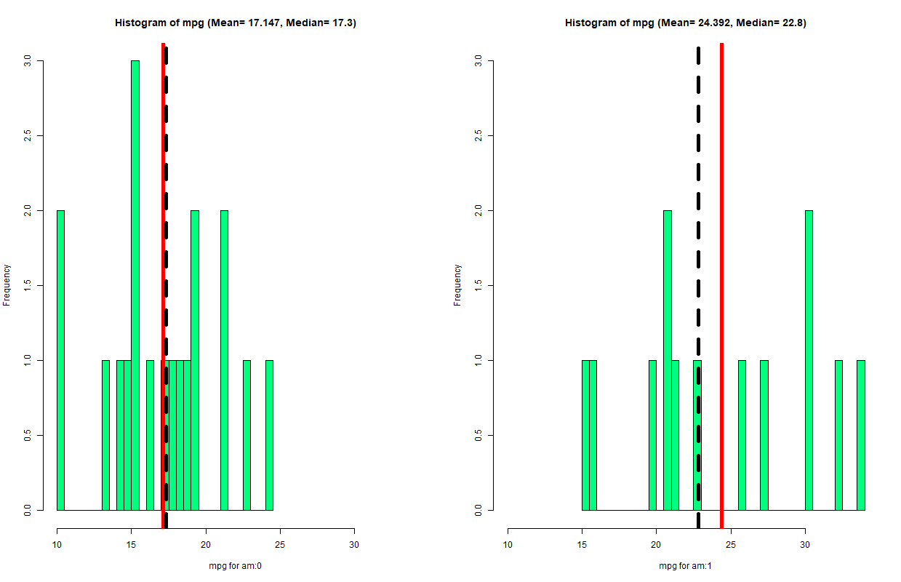
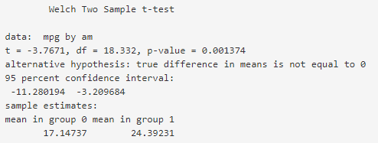
t-test on miles-per-gallon: Automatic vs. manual transmission
Difference= 17.14- 24.39= -7.25
SE=1.92
Test statistic= -7.25/ 1.92= -3.77
Test stats can be + or -, it is ok.
Automatic
= 17 mpg
Manual
= 24 mpg
Significant at the p < 0.01 level.
The 95% CI for differences does not contain 0, therefore it is significant.
Automatic transmissions have a narrower distribution with lower MPGs. Manual transmissions have a wider distribution.

Slide 12
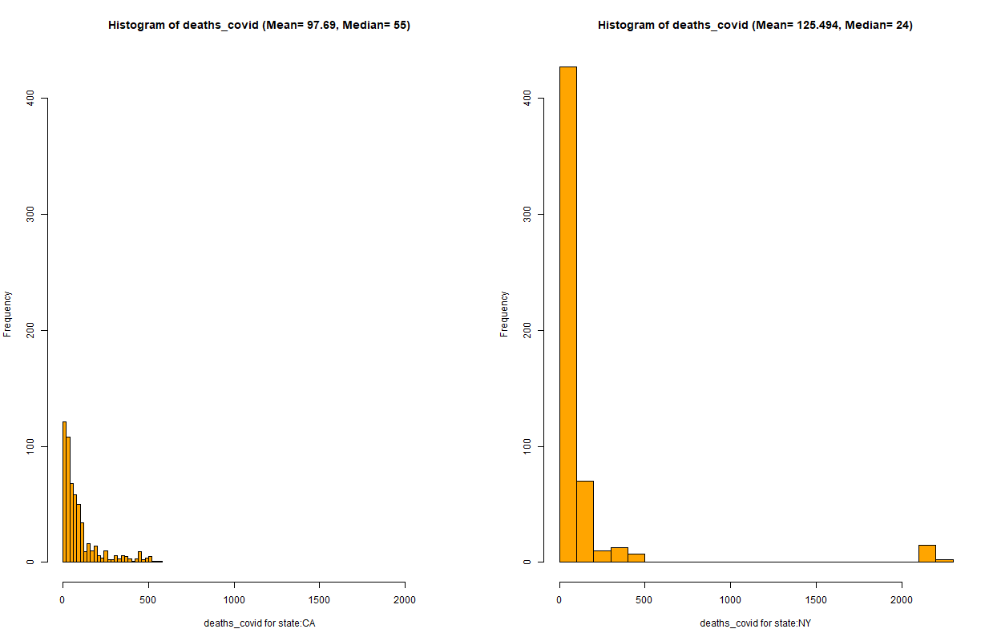
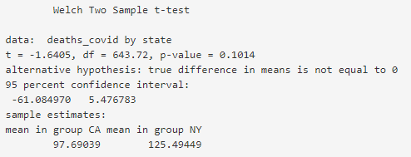
t-test: Daily covid deaths in CA and NY (2020-2021)
The test statistic, t= -1.64 doesn’t exceed the critical value of -1.96.
Not significant at the p < 0.05 level.
The distributions look different. CA has more normality but both are positively skewed.
NY has greater numbers of days on the very low and very high ends.
The 95% CI for differences contains 0, therefore it is not significant.

Slide 13
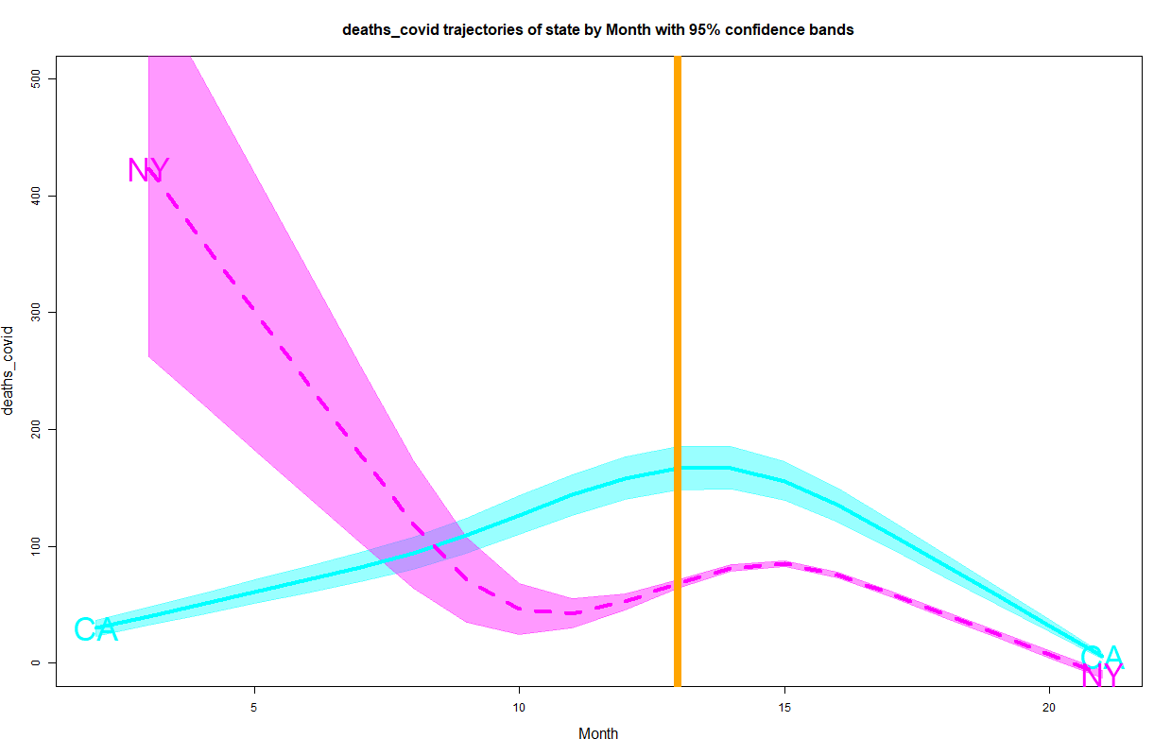
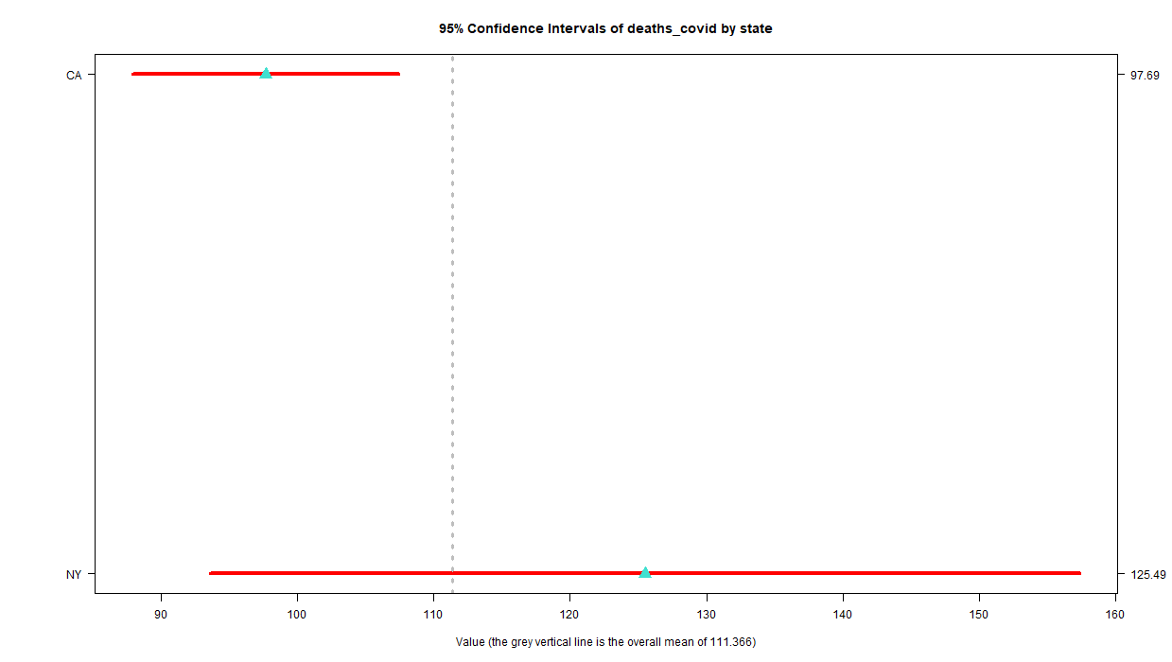
Exploratory analysis to explain non-significant results
CA and NY’s 95% CIs show they have significantly different rates over time. NY’s rates has the highest variation. CA finishes higher.
CA has a narrower 95% CI suggesting more consistency over time. CA’s average falls within NY’s 95% CI. No significant difference.
January, 2021
NY has a wider 95% CI suggesting more variation over time.
Time is important in understanding differences in average daily covid death rates. CA and NY had significantly alternating levels over time.
2020 and 2021 paint different pictures.

Slide 14
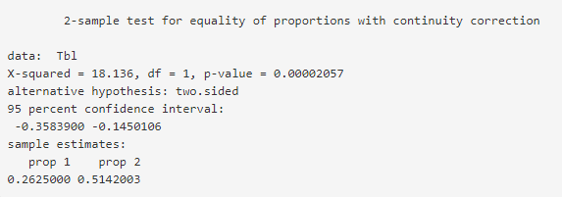
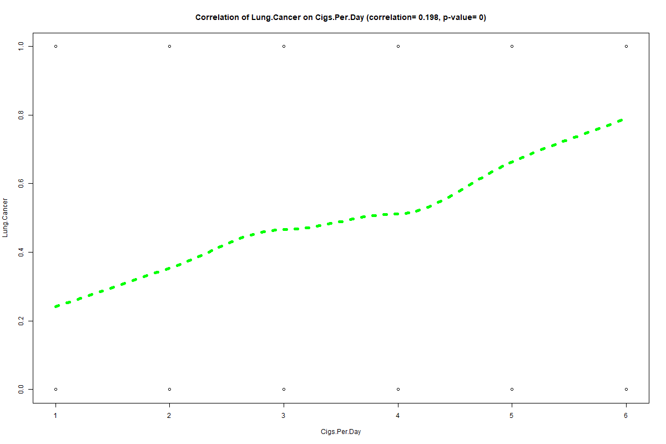
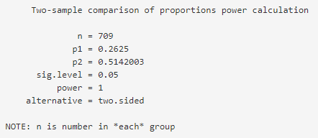
Binomial proportion test: 1950 Smoking and lung cancer study (Doll & Hill)
Proportion test
Test statistic
Very significant
The 95% CI doesn’t contain 0
There is a significant (p < 0.001) and positive correlation between lung cancer and levels of cigarettes smoked per day.
26% of non-smokers had lung cancer (n= 21).
51% of smokers had lung cancer (n= 588).
Power analysis
Levels range from 0 to 50+
Because of the large difference in rates between smokers and non-smokers and the big sample, post-hoc power = 100%.

